Slide 1
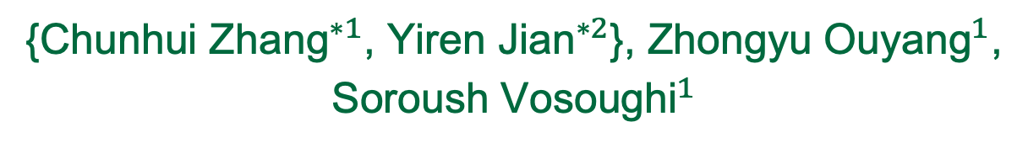

Pretrained Image-Text Models are Secretly Video Captioners
{${\text{Chunhui} \text{Zhang}}^{∗1}$, ${\text{Yiren} \text{Jian}}^{∗2}$}, ${\text{Zhongyu} \text{Ouyang}}^{1}$, ${\text{Soroush} \text{Vosoughi}}^{1}$
${}^{1}$Dartmouth College, ${}^{2}$OpenAI
Reinforcement learning helped us achieve
a Top-2 ranking on the PaperWithCode leaderboard.

Slide 2
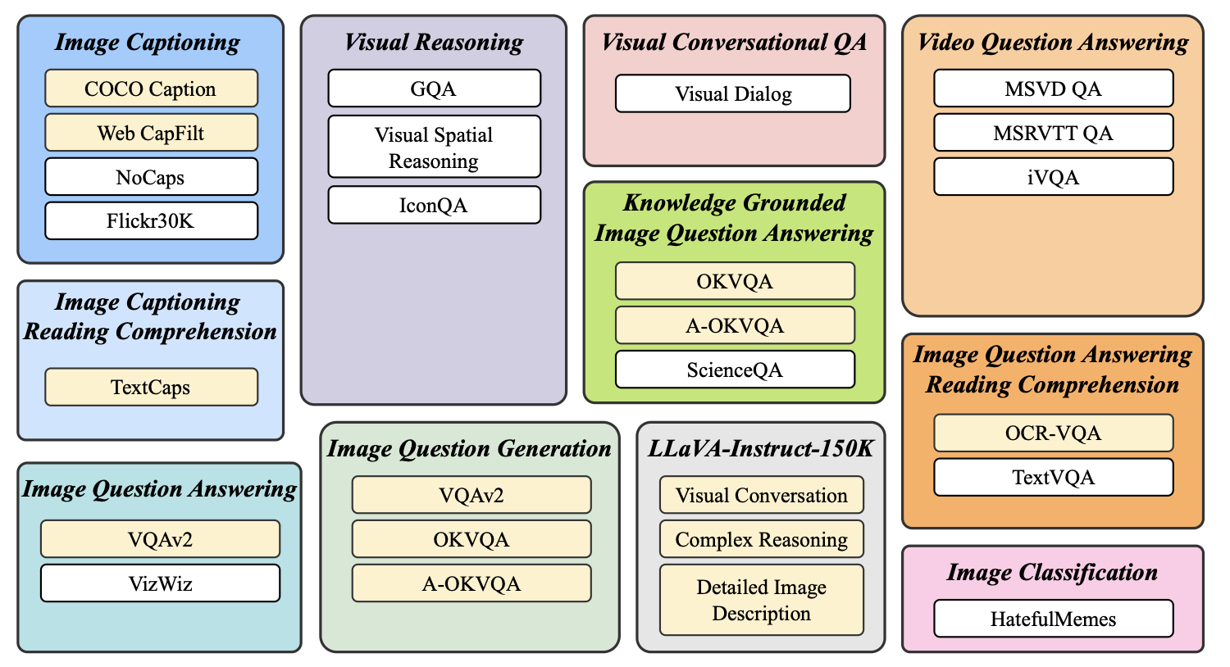
Recap
Image-text model -> instruction tuning -> zero-shot tasks
Figure copied from InstructBLIP paper

Slide 3
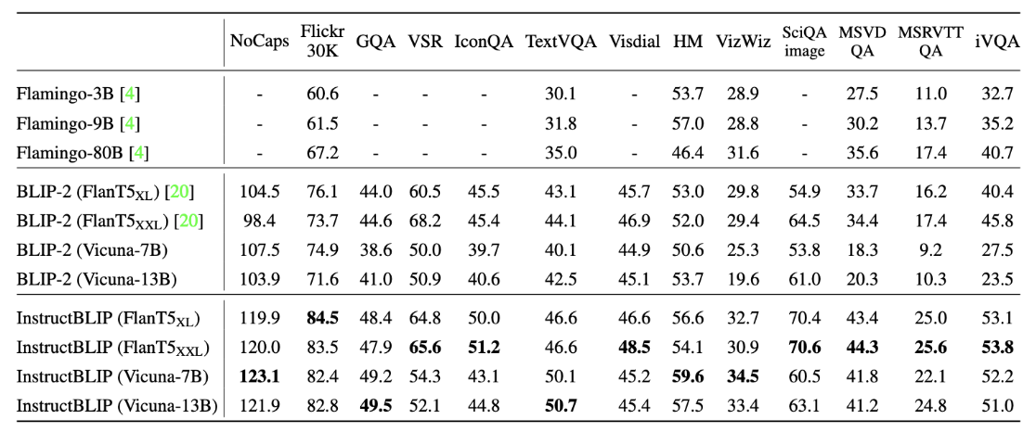
Challenges
Image-text models excel at zero shot learning in image QA but MSRVTT Video QA.

Slide 4
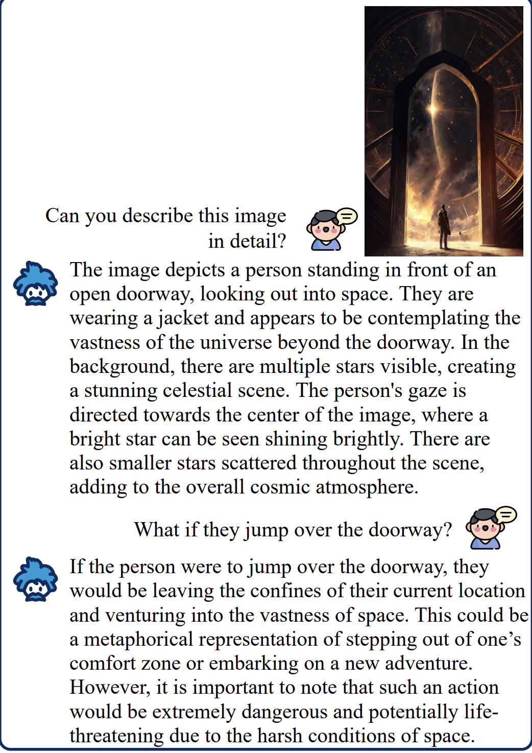
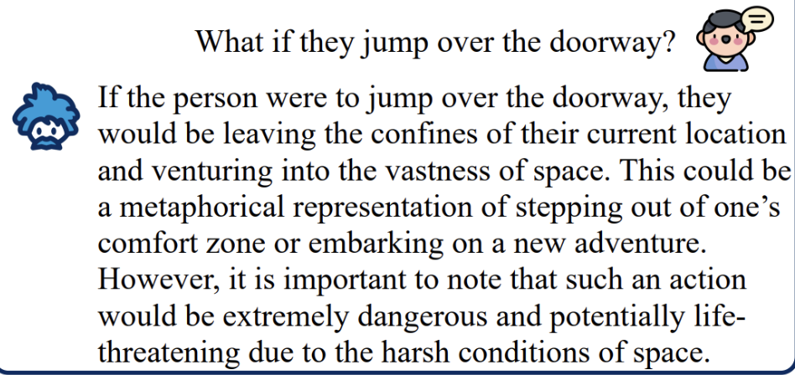
Shortcut Hypothesis
Image-text models may be using shortcuts from text to hack the VQA tasks.
Less focus on visual input
“Person might be caught in mid air on a sky”

Slide 5
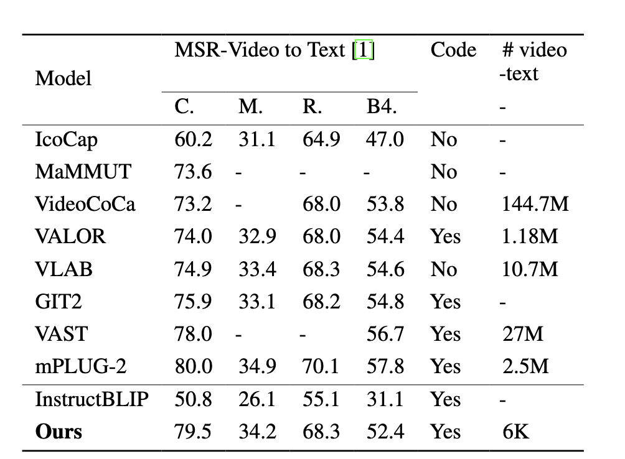
Shortcut on Video Captioning
Video captioning requires direct understanding on visual inputs,
but image-text models are weak on it.

Slide 6
Break Shortcut
Under resource constraints (model, data, supervision), how can we let image-text models focus on videos for producing captioning?

Slide 7
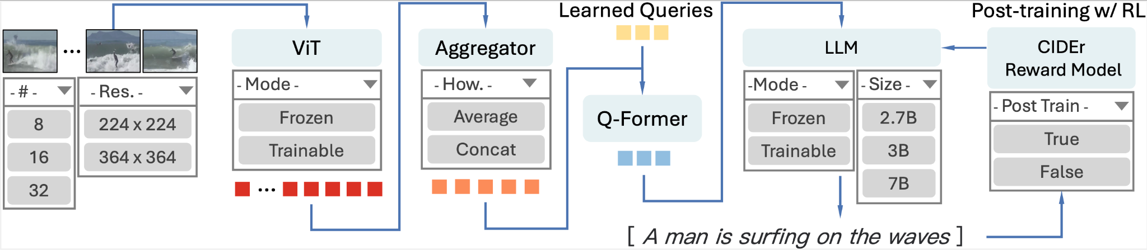
RL supervision
We use CIDEr score as metric-based reward to reinforce video captioning.
Notes:
in supervised learning, output the caption, it only tried to predict the same caption text. For reinforcement learning supervision, the model tried to learn the output the text that have better CIDER score.
For supervised learning, they only use cross entropy
Finetune the Q-Former LLM
Q-Fromer is the most triable one/ doesn’t impact the final result significantly,
train all components
freeze ViT only, train Q former only
RL with Cider metrics, so that it can generate sequence with human-like sequence

Slide 8
Model Architecture
ViT + Q-Former + Flan-T5-XL
Video inputs: multiple frames
Frames embeddings were concatenated
Notes:
in supervised learning, output the caption, it only tried to predict the same caption text. For reinforcement learning supervision, the model tried to learn the output the text that have better CIDER score.
For supervised learning, they only use cross entropy
Finetune the Q-Former LLM
Q-Fromer is the most triable one/ doesn’t impact the final result significantly,
train all components
freeze ViT only, train Q former only
RL with Cider metrics, so that it can generate sequence with human-like sequence

Slide 9
Optimal Recipe
Fine-tune InstructBLIP model on MSR-VTT-Caption dataset with
1) Post-Training with RL 2) updating Q-Former Only
3) Moderate Video Quality
Notes:
Uses Cider reward model -> so that it focuses more on captions that are more semantically close even if it deviates from ground truth
the model would automatically know how to achieve captions that resemble the ones humans created it
let the model to directly optimize the CIDER score/ which measures whether the language resembles the ones humans created it
cross entropy is differentiable
but the metric is not differentiable so we use the reinforcement learning
parameters are the ones we control and we test on which combination works the best

Slide 10
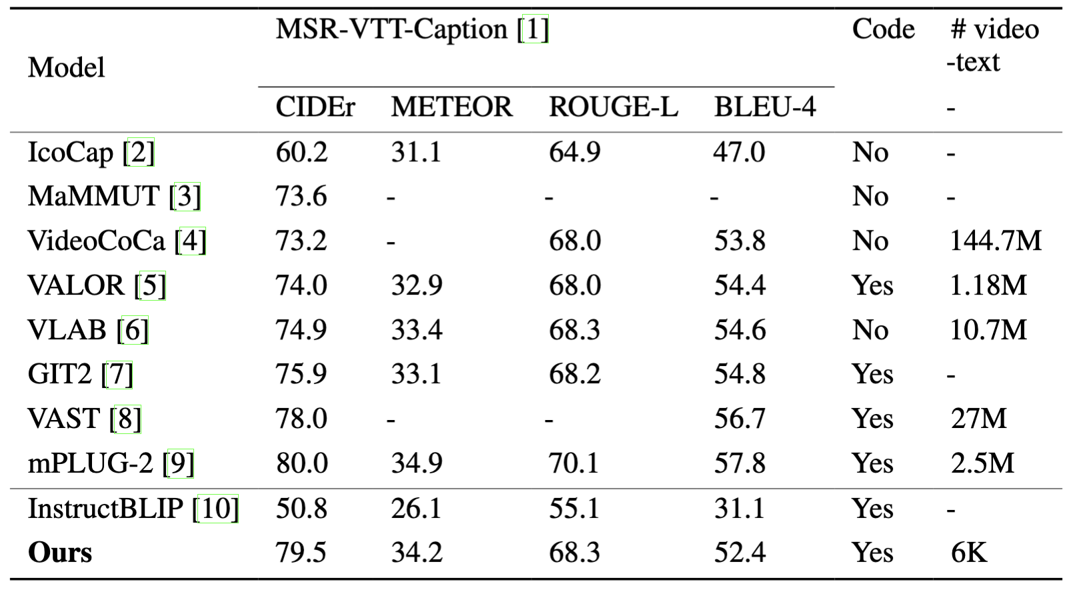
We achieved 2nd best against SoTA video captioners

Slide 11
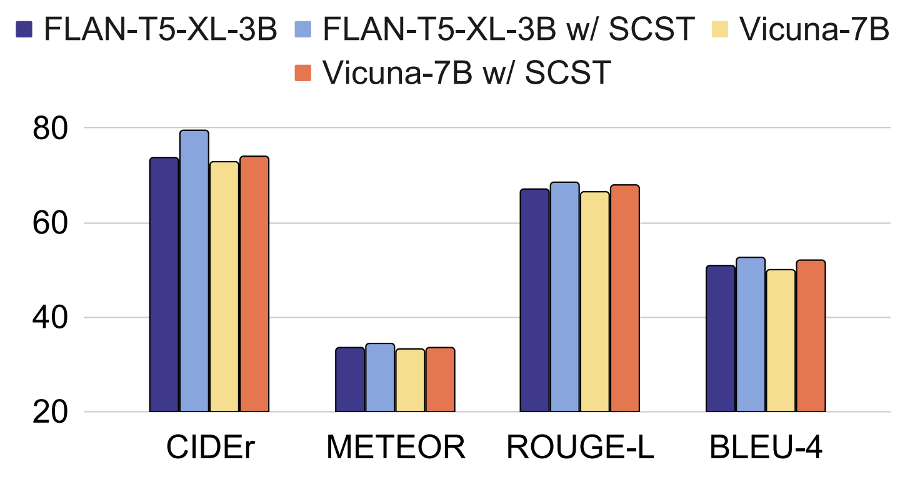
Key Findings
RL Supervision:
Reinforcement learning (SCST) aligns captions with human preferences
Improved CIDEr scores by 3.4-6.5%

Slide 12
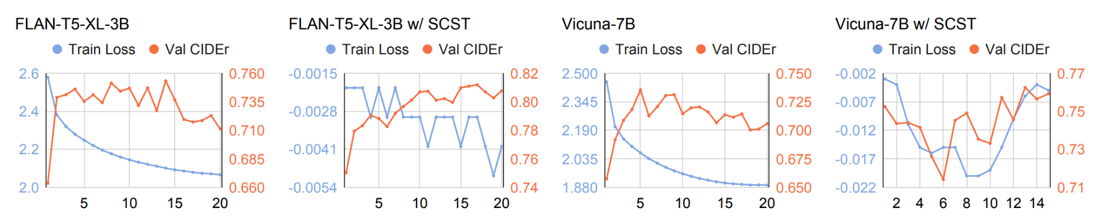
Key Findings
RL Supervision:
RL achieves optimal performance very few epochs.

Slide 13
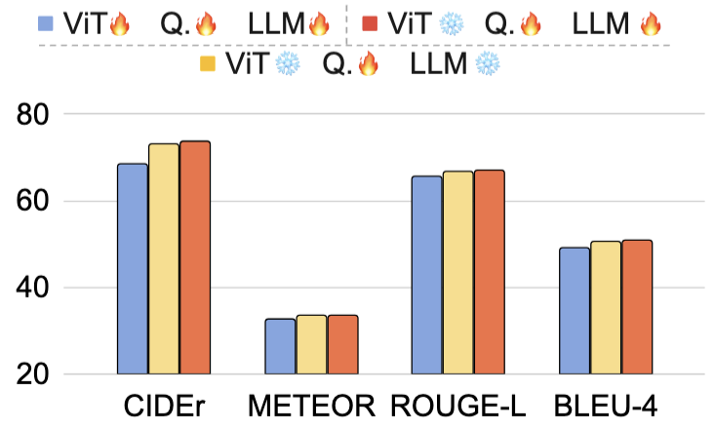
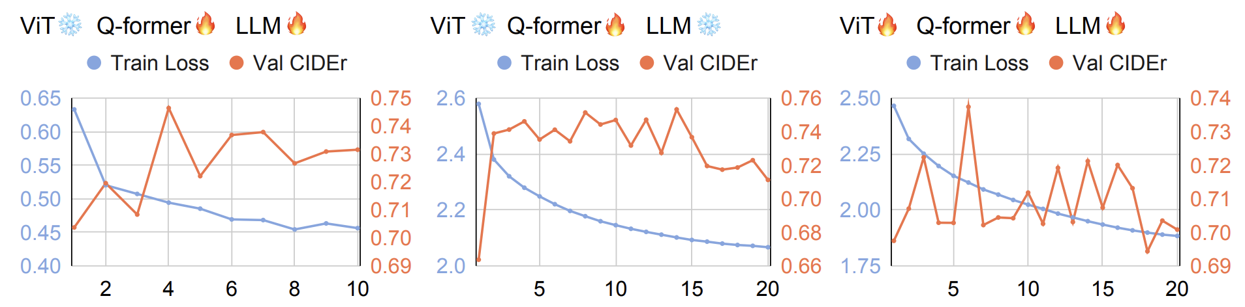
Key Findings
Model Scale:
Trainability hierarchy: Q-Former > LLM > ViT

Slide 14
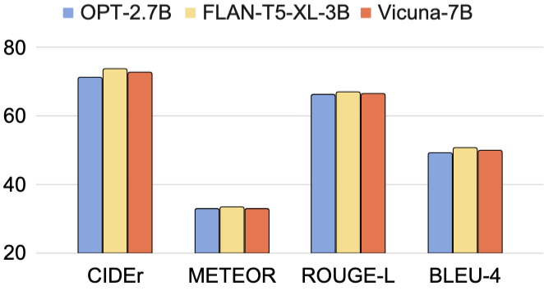
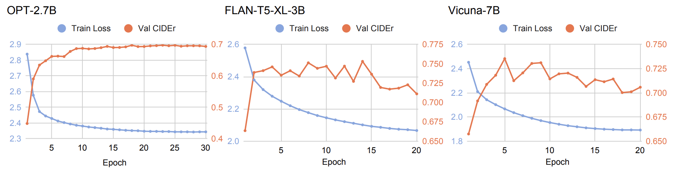
Key Findings
Model Scale:
Mid-sized LLMs (e.g. 3B) work best for video captioning

Slide 15
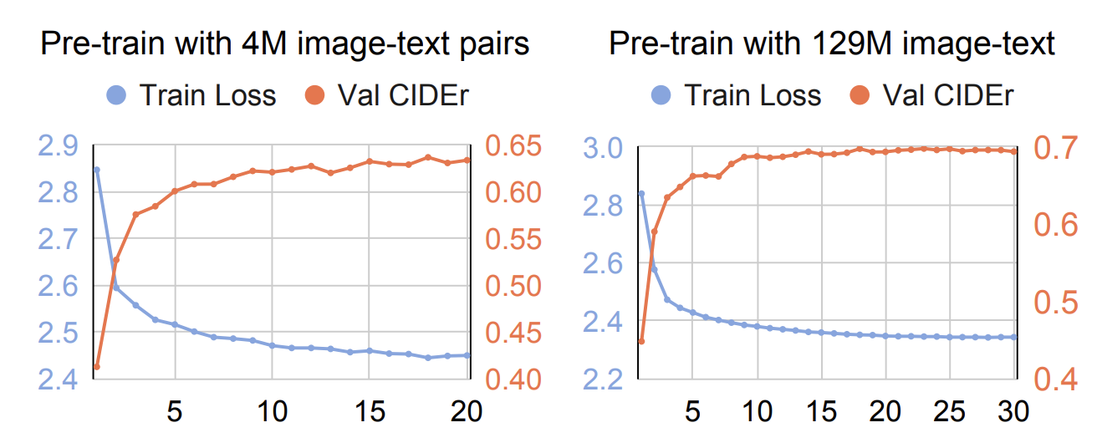
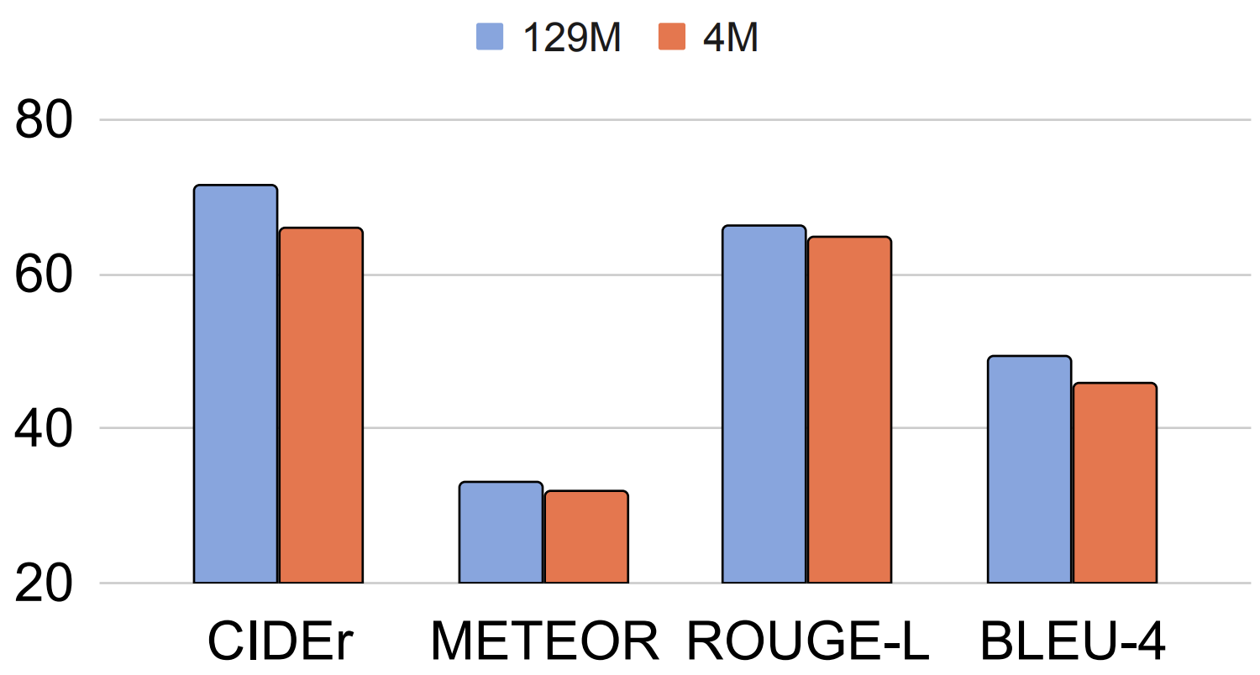
Key Findings
Data Efficiency:
Larger image-text pretraining datasets provides good initializations

Slide 16
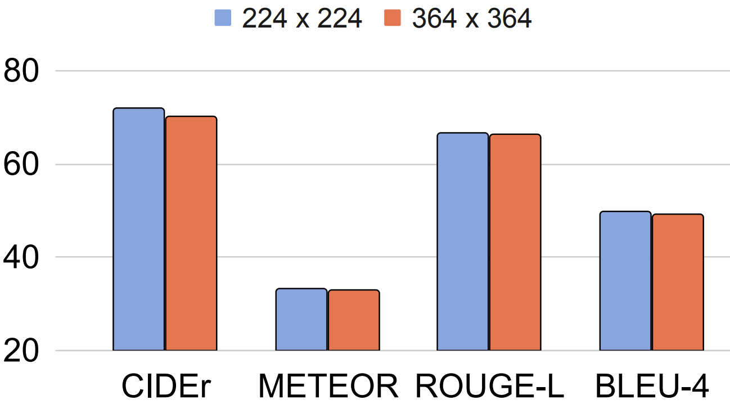
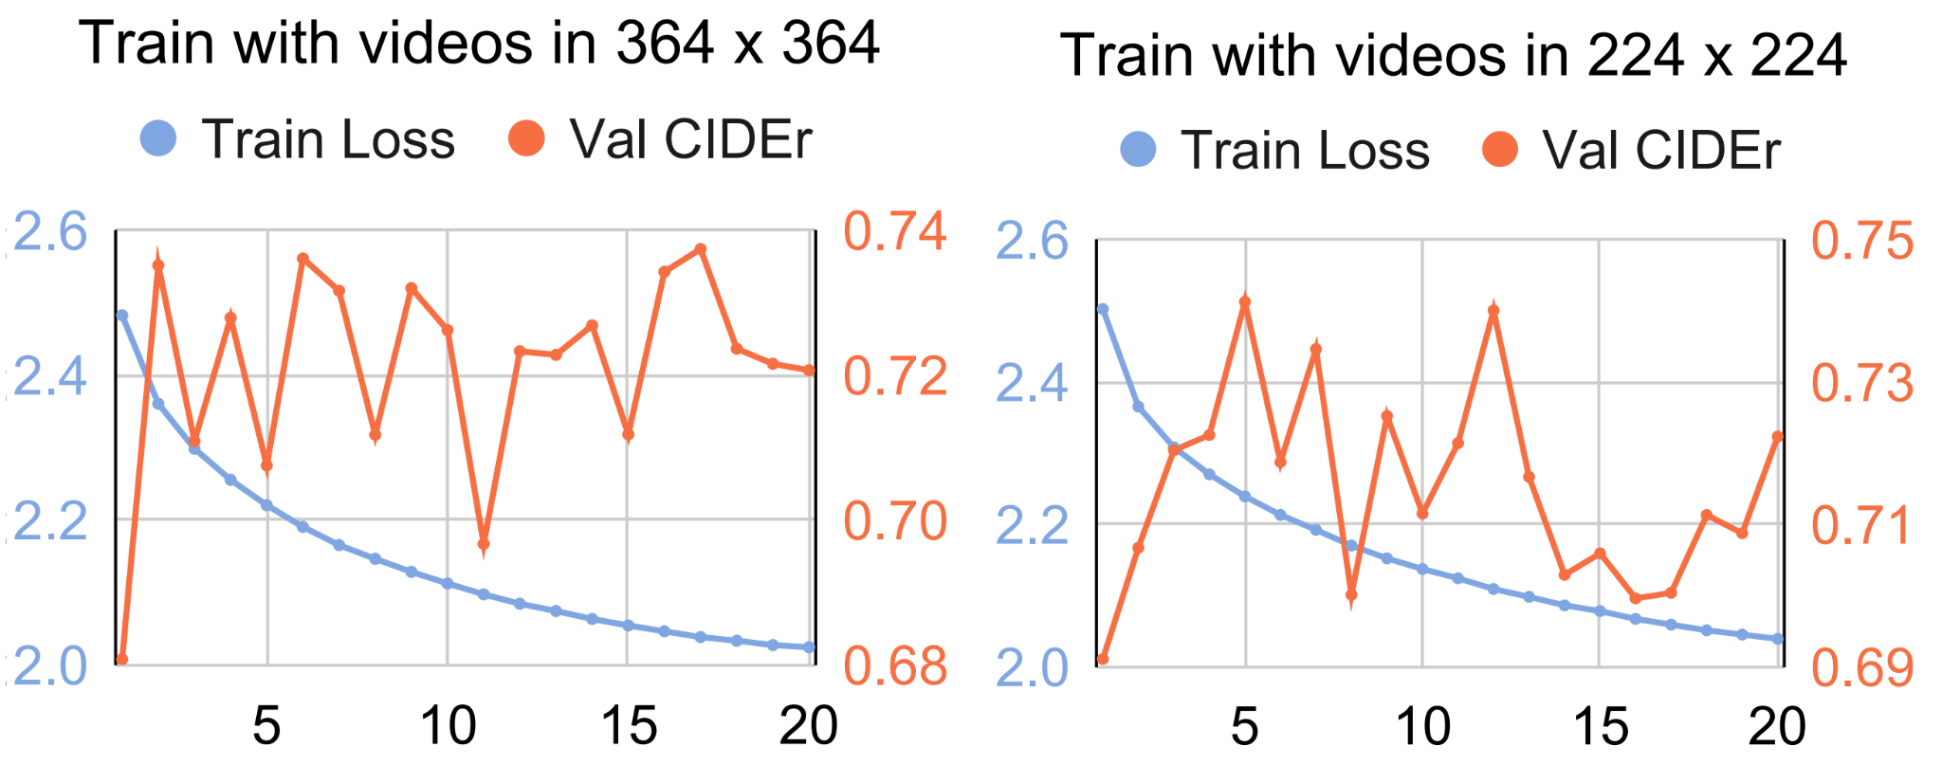
Key Findings
Data Efficiency:
Lower resolution (224x224) works efficiently

Slide 17
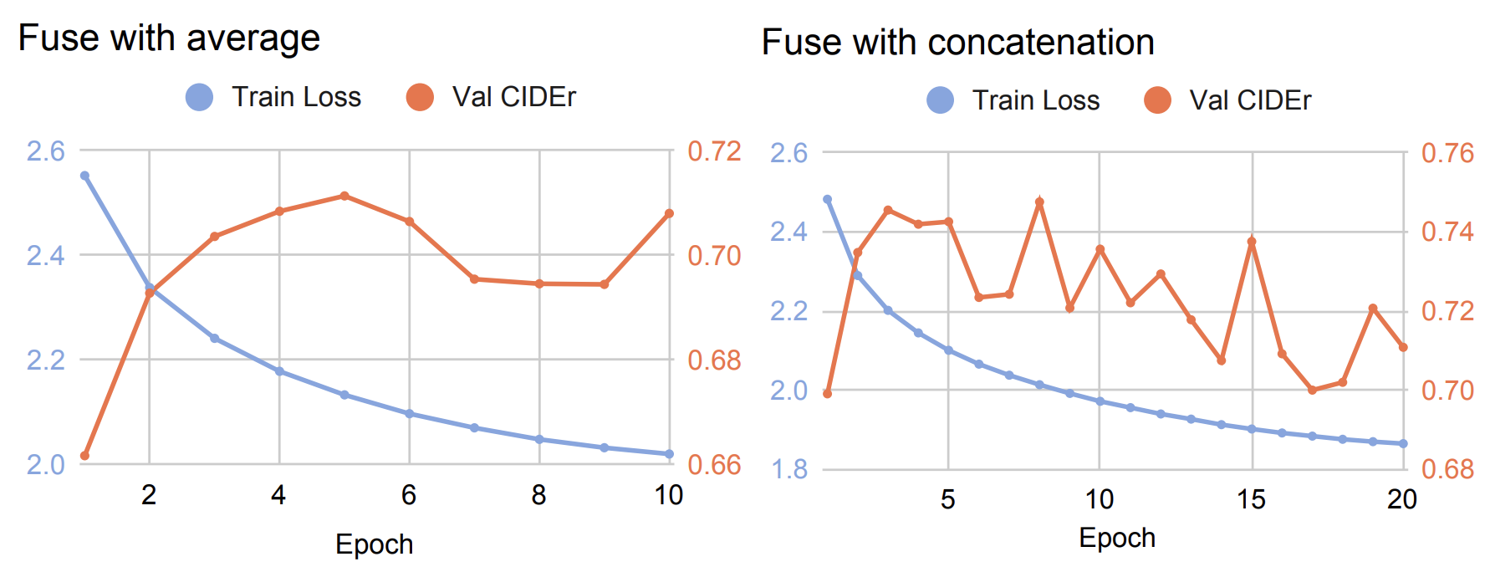
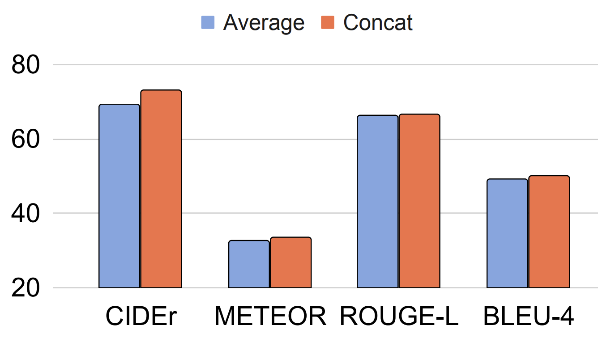
Key Findings
Data Efficiency:
Frame concatenation better captures temporality than averaging

Slide 18
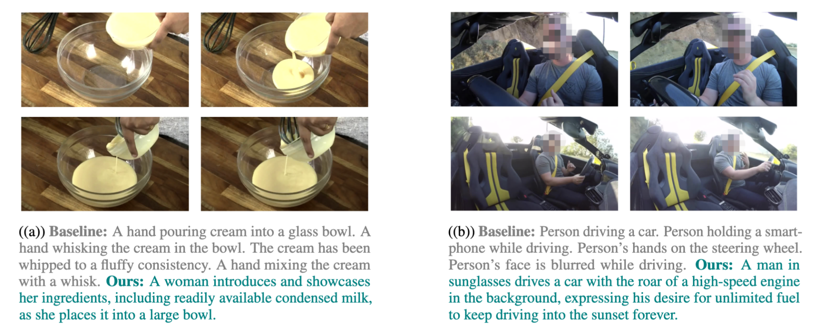
Qualitative Comparison: image-text model v.s. Ours
Notes:
The qualitative comparison highlights significant differences between the captions generated by InstructBLIP and our model. InstructBLIP, which lacks training on extensive video captioning datasets, struggles to capture the visual dynamics and temporal coherence across different frames. Its captions are often static, describing isolated frames without integrating temporal changes or interactions. In contrast, our model demonstrates a nuanced understanding of visual dynamics across temporal frames, effectively integrating information to produce contextually rich and temporally coherent descriptions. This improvement can be attributed to the visual captioning training incorporated in our model, enabling it to better interpret and narrate dynamic visual content.

Slide 19
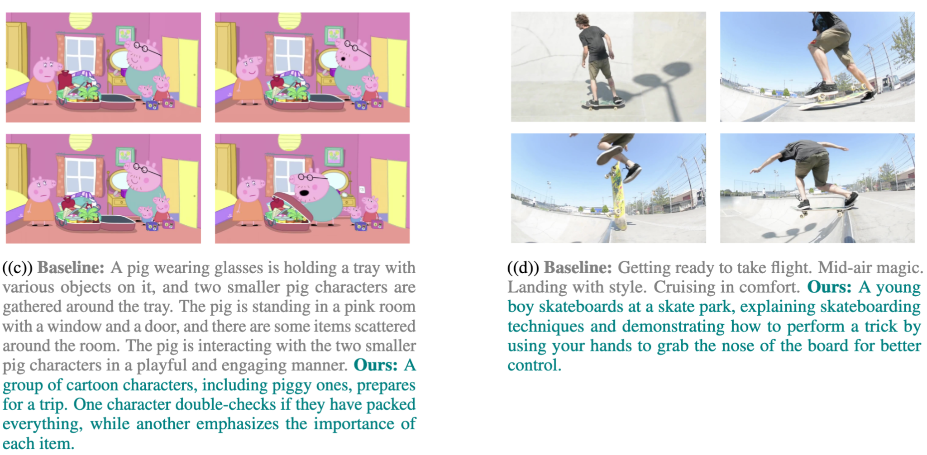
Qualitative Comparison: image-text model v.s. Ours
Notes:
The qualitative comparison highlights significant differences between the captions generated by InstructBLIP and our model. InstructBLIP, which lacks training on extensive video captioning datasets, struggles to capture the visual dynamics and temporal coherence across different frames. Its captions are often static, describing isolated frames without integrating temporal changes or interactions. In contrast, our model demonstrates a nuanced understanding of visual dynamics across temporal frames, effectively integrating information to produce contextually rich and temporally coherent descriptions. This improvement can be attributed to the visual captioning training incorporated in our model, enabling it to better interpret and narrate dynamic visual content.

Slide 20
Summary
Identified shortcut in current image-text model’s visual understanding
Key factors for recycling image-text model to video captioning
Achieved top performance with minimal resources by RL

